Slide 1
The Fountain Institute was founded in 2003 with the intention of providing the community of Luton with access to traditional Islamic knowledge.

Slide 2
OUR VISION
“Our vision is to offer a contemporary yet traditional learning experience. That is sourced in Islam’s great heritage of knowledge. In the challenge of sacred learning, the individual embarks on a journey to refine and develop their impetuous state to a spiritual focused, high-minded, principled one; a person committed to his self and societal benefit through the good they can offer.”
Notes:
To nurture holistic faith-based communities having at its heart an educational institution that imparts a broad and relevant traditional Islamic curriculum.
This vision is underpinned by the principles of sincerity, excellence and education rooted in practice; binding formal learning to the imperative of action and seeing education as a transformative process and not merely informative.

Slide 3
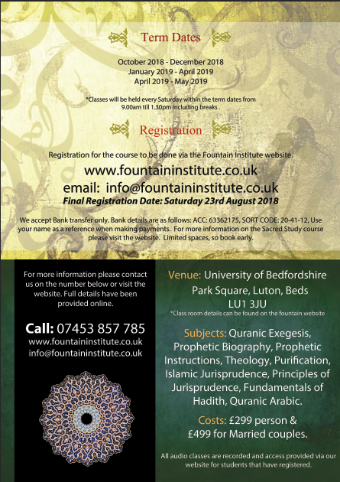

Slide 4
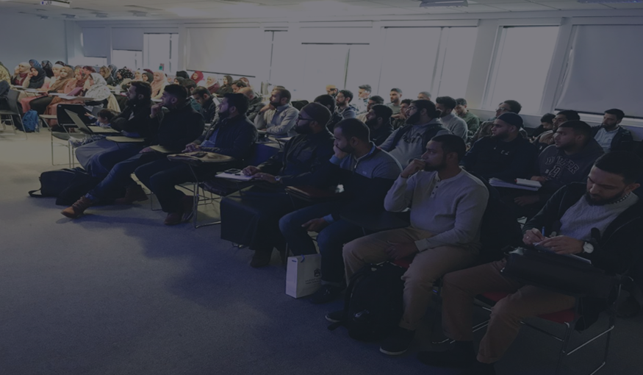
Not only been an incredible experience, but a backbone in my life. I am not a studious person but Sacred Study has been a foundation of much good for me in many more ways than just knowledge. I sincerely thank you from the bottom of my heart.

Slide 5
The Fountain Institute was founded in 2003 with the intention of providing the community of Luton with access to traditional Islamic knowledge.

Slide 7
Thank you for facilitating my weekly dose of much, much good which further extends to eternal goodness I hope InshaAllah. Thank you for facilitating for me a different way of thinking and approaching life, influenced by our beautiful, blessed teachers.

Slide 8
The Fountain Institute was founded in 2003 with the intention of providing the community of Luton with access to traditional Islamic knowledge.

Slide 10
May He please your hearts a million times more for the pleasure you facilitated for my heart. May He increase and preserve your good works for the Ummah and accept them from you May forgive you, love you, protect you and have mercy on you eternally. I pray He gives you all the beautiful things in His dominion! May you be with Allah and His Messenger ^{s}, Ameen.

Slide 11
The Fountain Institute was founded in 2003 with the intention of providing the community of Luton with access to traditional Islamic knowledge.

Slide 13
Alhamdulillah, a brilliant course which teaches you the fundamentals about the deen with lots of reminders that give you direction in the way to live your daily life, I really love the purification lessons , you learn many lessons Alhamdulillah, may Allah bless Fountain institute and our teachers with His immense love and mercy for facilitating this course and accept their great efforts, ameen.

Slide 14
The Fountain Institute was founded in 2003 with the intention of providing the community of Luton with access to traditional Islamic knowledge.

Slide 16
This is my first year of Sacred Study and Alhamdulilah I have to say that I absolutely love it! Our wonderful teachers are a blessing. The way they teach and how they talk to students, you enjoy the classes and learn from them as much as possible. I look forward to Sacred Study every week! Everyone is so welcoming and kind Alhamdulilah.

Slide 17
The Fountain Institute was founded in 2003 with the intention of providing the community of Luton with access to traditional Islamic knowledge.

Slide 19
A beautiful class with teachers so full of knowledge yet humble... Each of them with their own unique method of teaching keeping everyone awake on a Saturday morning :-) All the subjects brilliant and necessary for us to learn about, enabling us to really understand our deen.... Jazakallah to Fountain Institute and all those who put time and effort in to providing us with these learning opportunities...Even after a busy week always look forward to Sacred Study.

Slide 20
The Fountain Institute was founded in 2003 with the intention of providing the community of Luton with access to traditional Islamic knowledge.

Slide 22
Allhamdhulillah, the Sacred Study course is doing so well. My words wouldn't do justice to the teachers, so I will stop here and just say that I am absolutely blessed to be in the presence of such teachers and to be able to learn sacred knowledge directly from them. May Allah increase this course in numbers and strength. Ameen.

